Slide 1
Python
Part 2
“**” means not testable material

Slide 2
HOFs with lambdas **
>>> nums = [1, 2, 3, 4]
>>> foo = list(map(lambda x: x*x, nums))
>>> foo
[1, 4, 9, 16]
>>> bar = list(filter(lambda y: y % 2 == 0, nums))
>>> bar
[2, 4]
*filter == keep, btw

Slide 3
Lambdas: you hate to love them **
>>> square = lambda x: x*x
What the heck is that?
It’s a lambda expression, and they’re quite useful.
The word “lambda” begins a lambda expression.
The action of the function goes last!
lambda x: x*x
The variables used are noted here.

Slide 4
[‘Lists’, ‘are’, ‘the’, ‘greatest’]
>>> my_list = [7, 6, 5, 4, 3]
>>> print(my_list)
[7, 6, 5, 4, 3]
>>> names = [‘Spongebob’, ‘Patrick’, ‘Sandy’]
Lists can hold lots of types of data: numbers, strings, even other lists!

Slide 5
Manipulating Lists
>>> plain = [1, ‘thing’, 2, ‘do’, 3, ‘words’]
>>> white = [4, ‘you’]
>>> theres_only = plain + white
>>> theres_only
[1, ‘thing’, 2, ‘do’, 3, ‘words’, 4, ‘you’]

Slide 6
A note on append
>>> plain = [1, ‘thing’, 2, ‘do’, 3, ‘words’]
>>> white = [4, ‘you’]
>>> plain.append(white)
>>> plain
[1, ‘thing’, 2, ‘do’, 3, ‘words’, [4, ‘you’]]

Slide 7
List Indices
>>> my_list = [‘Ah’, ‘luhv’, ‘kittehz’]
>>> my_list[0]
‘Ah’
>>> my_list[1]
‘luhv’
>>> my_list[2]
‘kittehz’
You can get items from a list with this notation <--
The number in the hard brackets indicates the index of the item you want.

Slide 8
List Length
length function in Python noted by len()
>>> len([item0, item1, item2])
3

Slide 9
Mutability
>>> my_list = [17, 45, 100]
>>> my_list[1] = ‘altered’
>>> my_list
[17, ‘altered’, 100]
>>> my_list[3]
IndexError: list index out of range
Lists are “mutable” data, which means you can change them after they are created.

Slide 10
Some Utilities (Lists)
lst[1:]
lst[:-1]
lst.append(x)
x in lst
x not in lst
lst[n:k]
“All but first”
“All but last”
“Add x as the last item of lst”
True if x is an item of lst
True if x is not an item of lst
Item n to item k not including item k from lst

Slide 11
A simple list loop
>>> boop = [‘iterate’, ‘over’, ‘me’]
>>> for beep in boop:
... print(beep)
...
‘iterate’
‘over’
‘me’
It’s easy to iterate over lists in Python! Use:
>>>for (thing) in (list):
... do stuff here

Slide 12
Dictionaries
>>> my_dict = {‘key’:‘value’, ‘key2’:‘value2’}
>>> my_dict[‘key2’] == ‘value2’
True
>>> my_dict[‘key3’] = ‘value3’
>>> my_dict[‘key3’]
‘value3’

Slide 13
>>> scores = {}
>>> num = 60
>>> for task in [‘hw’, ‘quiz’, ‘test’]:
... scores[task] = num
... num += 20
...
>>> scores
{‘hw’: 60, ‘quiz’: 80, ‘test’: 100}

Slide 14
.get method
>>> Scores
{‘hw’: 60, ‘quiz’: 80, ‘test’: 100}
>>> Scores.get(80)
>>> Scores.get(‘quiz’)
80
<--Doesn’t return anything!

Slide 15
Dictionaries are Mutable!
>>> browsers = {‘IE’:‘good’, ‘Firefox’:‘better’, ‘Chrome’:‘best’}
>>> browsers[‘IE’] = ‘supreme’
>>> browsers
{‘Chrome’:‘best’, ‘IE’:‘supreme’, ‘Firefox’:‘better’}

Slide 16
To the Prompts!
>>>

Slide 17
Even numbers in a list:
def even_numbers(num_lst):
“””Given a list, return the even
numbers in this list.”””

Slide 18
Even numbers in a list:
def even_numbers(num_lst):
return [item for item in num_lst if item % 2 == 0]
>>> even_numbers([3, 2, 5, 8])
[2, 8]
# Alternative is even_list.append(item)
Notes:
x = [0,1,2,3,4]
x = x[1:]

Slide 19
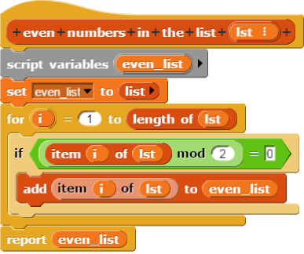
Even numbers (Snap!):

Slide 20
Letters with Ascii:
def letters_with_ascii(letters_list):
"""Given a list of letters, return a dictionary that binds each letter to its ascii value (unicode in Snap).
Ascii values can be determined by the ord(letter) function. For example, ord(‘a’) = 97."""

Slide 21
Letters with Ascii:
def letters_with_ascii(letters_list):
dictionary = {}
for letter in letters_list:
dictionary[letter] = ord(letter)
return dictionary
>>> letters = [‘c’,‘s’,‘f’,‘u’,‘n’]
>>> letters_with_ascii(letters)
{‘f’:102, ‘n’:110, ‘u’:117, ‘c’:99, ‘s’:115}

Slide 22
Evil Dictionary Changer
def evil_changer(dictionary, letter, new_value):
"""Dr. Evil is trying to teach you a lesson about using ASCII! Guess you ASKiied for it!
Given a dictionary, change the value for the key “letter” to be “new_value”, and return the dictionary."""

Slide 23
Evil Dictionary Changer
def evil_changer(dictionary, letter, value):
if letter in dictionary.keys():
dictionary[letter] = value
return dictionary

Slide 24
Evil Dictionary Changer
>>> dictionary = letters_with_ascii(letters)
>>> dictionary
{‘f’:102, ‘n’:110, ‘u’:117, ‘c’:99, ‘s’:115}
>>> evil_changer(dictionary,'n',5)
{‘f’:102, ‘n’:5, ‘u’:117, ‘c’:99, ‘s’:115}
>>> dictionary
{‘f’:102, ‘n’:5, ‘u’:117, ‘c’:99, ‘s’:115}
# The dictionary itself is changed!

Slide 25
Evil Dictionary Changer
>>> evil_changer(dictionary,‘s’, [‘I WIN’, ‘YOU LOSE’])
{‘f’:102, ‘n’:5, ‘u’:117, ‘c’:99, ‘s’:[‘I WIN’, ‘YOU LOSE’]}
# dictionaries can hold anything, including lists!

Slide 26
Matching Letters
def matching(word_list, match_word, k):
“““Print the words in the word_list that
have at least k of the same letters as match_word.”””
>>> matching([‘cat’,‘bat’,‘row’],‘rat’, 2)
‘cat’
‘bat’

Slide 27
Matching Letters
def matching(word_list, word_to_match, k):
for _______ in __________:
count = 0
for letter in _____:
if _____ in ________:
______ += 1
if ______ >= k:
___________________

Slide 28
Matching Letters
def matching(word_list, match_word, k):
for word in word_list:
count = 0
for letter in word:
if letter in match_word:
count += 1
if count >= k:
print (word)
break
What is the runtime?
“break” gets out of the inner ‘for’ loop and goes back to the outer loop

Slide 29
Every other item in list
def every_other(lst):
“””Given a list, return every other item in this list.”””

Slide 30
Every other item in list
Notice that “i” here represents the index in the list
def every_other(lst):
output_list = []
for i in range(len(lst)):
if i % 2 == 0:
output_list.append(lst[i])
return output_list

Slide 31
Swap items of a list:
def swap(item_x, item_y, lst):
“””Given a list, swap item_x and
item_y in the list.”””
# assume item_x and item_y are indices

Slide 32
Swap items of a list:
def swap(item_x, item_y, lst):
temp = lst[item_x]
lst[item_x] = lst[item_y]
lst[item_y] = temp
>>> lst = [1, 2, 3, 4]
>>> swap(0, 2, lst)
>>> lst
[3, 2, 1, 4]

Slide 33
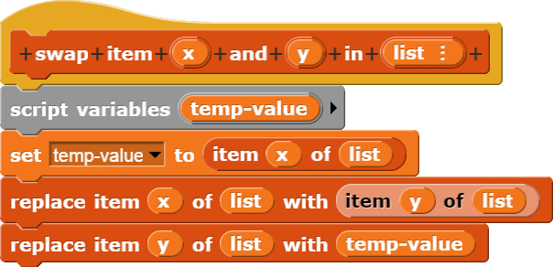
Swap items of a list (Snap!):

Slide 34
Make plurals:
def make_plurals(lst):
“””Given a list of words, return a list with
all the words plural.”””

Slide 35
Make plurals:
def make_plurals(lst):
return list(map(lambda string: string + ‘s’, lst))
>>> lst = [‘car’, ‘cdr’]
>>> make_plurals(lst)
[‘cars’, ‘cdrs’]
>>> lst
[‘car’, ‘cdr’]

Slide 36
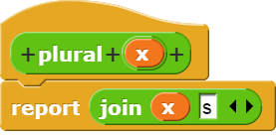
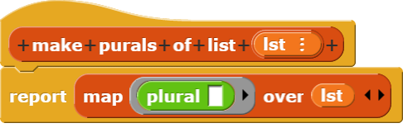
Make plurals (Snap!):

Slide 37
Find Missing
def find_missing(lst):
"""Given an unordered list from 0 to n but missing one number (e.g. [5,3,0,4,1]), find the missing number."""
>>> alist = list(range(5))
>>> alist
[0,1,2,3,4]
>>> 5 in alist
False

Slide 38
Find Missing
def find_missing(lst):
"""Given an unordered list from 0 to n but missing one number (e.g. [5,3,0,4,1]), find the missing number."""
for num in range(len(lst)+1):
if num not in lst:
print(num)

Slide 39
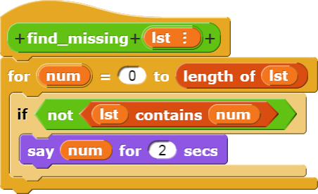
Find Missing
Leading Questions
Why is it (length of (lst)) and not ((length of (lst)) + 1))?
What would happen if we tried to report inside a for loop in Snap!? What about in Python?

Slide 40
Binary Search
def bin_search(item, lst, low, high):
"""Search for ITEM in range LOW to HIGH of a sorted list LST."""

Slide 41
Binary Search
def bin_search(item, lst, low, high):
"""Search for ITEM in range LOW to HIGH of a sorted list LST."""
while high >= low:
midpoint = (high + low) // 2
if lst[midpoint] == item: #return index
return midpoint
elif lst[midpoint] < item: #search upper half
low = midpoint + 1
else: #search lower half
high = midpoint - 1
return "Item not found."

Slide 42
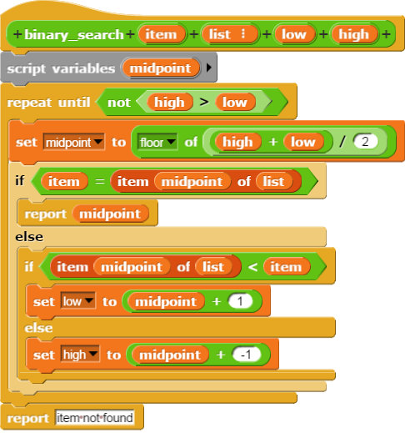
Binary Search

Slide 43
HOFs
We can also use functions that we created using “def” and variables assigned to functions! Let’s use square from two slides back. odd(x) returns “True” if x is odd.
>>> my_list = [1, 2, 3, 4]
>>> list(map(square, my_list))
[1, 4, 9, 16]
>>> list(filter(odd, my_list))
[1, 3]

